Slide 1



Lumio English
LESSON
10
IN THE KITCHEN
plate • cup • spoon • fork • knife • fridge • table • chair
LEVEL 1 · 8 NEW WORDS
Notes:
Welcome the class. Today: In the Kitchen. Goal: I can name things in the kitchen..

Slide 2



Lumio English
Welcome to Lumio English
2 / 29
Hello, little star!
Teacher says:
"Hello! Today we learn 8 new words!"
Notes:
Warm greeting. Set a positive, energetic tone.

Slide 3

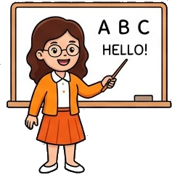
Lumio English
Today's Goals
3 / 29
By the end, you will:
1. Say 8 new words
2. I can name things in the kitchen.
3. Play games and earn stars
Notes:
Read goals aloud. Keep energy up.

Slide 4
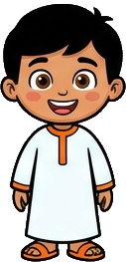

Lumio English
Warm-up • In the Kitchen
4 / 29
Let's get ready!
Stand up and stretch!
Say hello to a friend.
Clap your hands three times!
Notes:
2-3 minutes, high energy, physical movement.

Slide 5

Lumio English
Words for Today
5 / 29
8 new words
plate — طبق
cup — كوب
spoon — ملعقة
fork — شوكة
knife — سكين
fridge — ثلاجة
table — طاولة
chair — كرسي
Notes:
Preview words quickly. Don't teach yet, just build excitement.

Slide 6
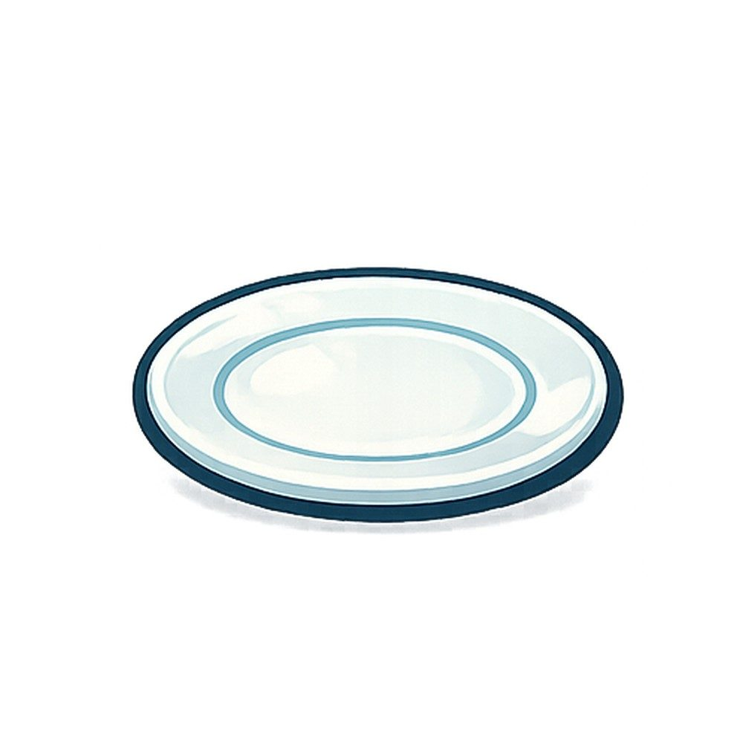
Lumio English
Vocabulary • plate
6 / 29
plate
طبق
SAY IT
"It is a plate."
Listen → Repeat ×3
Notes:
Model "plate" x2, choral repeat x3. Meaning: طبق. Sentence: It is a plate..

Slide 7

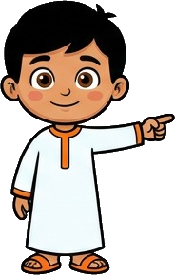
Lumio English
Practice • plate
7 / 29
Can you say it?
"It is a plate."
طبق
Notes:
Call on a student. Give first-sound hint if needed: "p..."

Slide 8


Lumio English
Vocabulary • cup
8 / 29
cup
كوب
SAY IT
"It is a cup."
Listen → Repeat ×3
Notes:
Model "cup" x2, choral repeat x3. Meaning: كوب. Sentence: It is a cup..

Slide 9
Lumio English
Practice • cup
9 / 29
Can you say it?
"It is a cup."
كوب
Notes:
Call on a student. Give first-sound hint if needed: "c..."

Slide 10


Lumio English
Vocabulary • spoon
10 / 29
spoon
ملعقة
SAY IT
"It is a spoon."
Listen → Repeat ×3
Notes:
Model "spoon" x2, choral repeat x3. Meaning: ملعقة. Sentence: It is a spoon..

Slide 11
Lumio English
Practice • spoon
11 / 29
Can you say it?
"It is a spoon."
ملعقة
Notes:
Call on a student. Give first-sound hint if needed: "s..."

Slide 12

Lumio English
Vocabulary • fork
12 / 29
fork
شوكة
SAY IT
"It is a fork."
Listen → Repeat ×3
Notes:
Model "fork" x2, choral repeat x3. Meaning: شوكة. Sentence: It is a fork..

Slide 13
Lumio English
Practice • fork
13 / 29
Can you say it?
"It is a fork."
شوكة
Notes:
Call on a student. Give first-sound hint if needed: "f..."

Slide 14
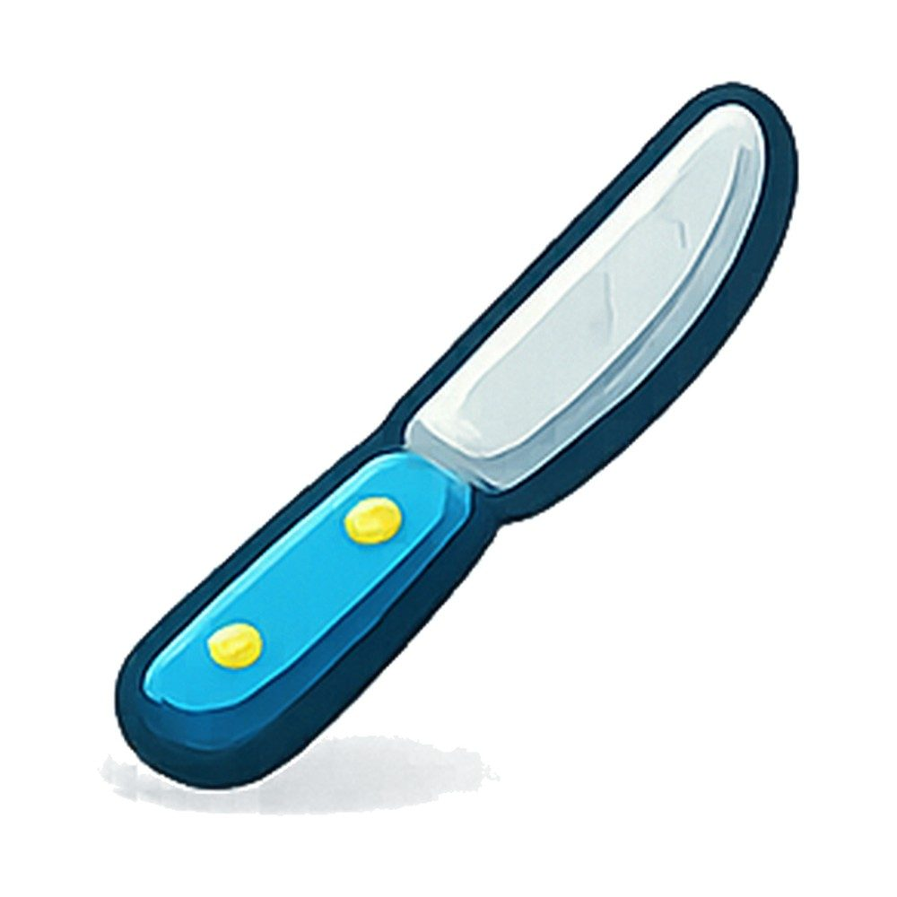
Lumio English
Vocabulary • knife
14 / 29
knife
سكين
SAY IT
"It is a knife."
Listen → Repeat ×3
Notes:
Model "knife" x2, choral repeat x3. Meaning: سكين. Sentence: It is a knife..

Slide 15
Lumio English
Practice • knife
15 / 29
Can you say it?
"It is a knife."
سكين
Notes:
Call on a student. Give first-sound hint if needed: "k..."

Slide 16

Lumio English
Vocabulary • fridge
16 / 29
fridge
ثلاجة
SAY IT
"The fridge is big."
Listen → Repeat ×3
Notes:
Model "fridge" x2, choral repeat x3. Meaning: ثلاجة. Sentence: The fridge is big..

Slide 17
Lumio English
Practice • fridge
17 / 29
Can you say it?
"The fridge is big."
ثلاجة
Notes:
Call on a student. Give first-sound hint if needed: "f..."

Slide 18
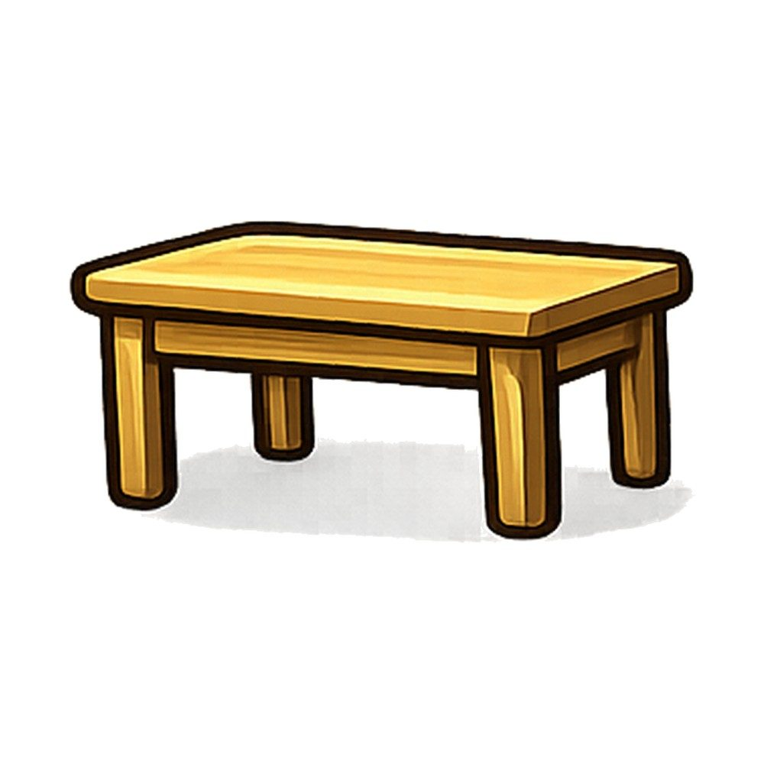
Lumio English
Vocabulary • table
18 / 29
table
طاولة
SAY IT
"The cup is on the table."
Listen → Repeat ×3
Notes:
Model "table" x2, choral repeat x3. Meaning: طاولة. Sentence: The cup is on the table..

Slide 19
Lumio English
Practice • table
19 / 29
Can you say it?
"The cup is on the table."
طاولة
Notes:
Call on a student. Give first-sound hint if needed: "t..."

Slide 20

Lumio English
Vocabulary • chair
20 / 29
chair
كرسي
SAY IT
"Sit on the chair."
Listen → Repeat ×3
Notes:
Model "chair" x2, choral repeat x3. Meaning: كرسي. Sentence: Sit on the chair..

Slide 21
Lumio English
Practice • chair
21 / 29
Can you say it?
"Sit on the chair."
كرسي
Notes:
Call on a student. Give first-sound hint if needed: "c..."

Slide 22

Lumio English
Listen and Repeat
22 / 29
My turn, your turn!
1. plate
2. cup
3. spoon
4. fork
5. knife
6. fridge
7. table
8. chair
Notes:
Point and say each word, students repeat.

Slide 23
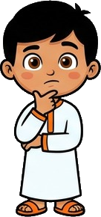
Lumio English
Your Turn • Round 1 of 3
23 / 29
What is this?
Notes:
Call a student by name. Answer: plate (طبق). Hint if needed: "p..."

Slide 24
Lumio English
Your Turn • Round 2 of 3
24 / 29
What is this?
Notes:
Call a student by name. Answer: cup (كوب). Hint if needed: "c..."

Slide 25
Lumio English
Your Turn • Round 3 of 3
25 / 29
What is this?
Notes:
Call a student by name. Answer: spoon (ملعقة). Hint if needed: "s..."

Slide 26

Lumio English
Game • Quiz 1 of 2
26 / 29
Which word means "طاولة"?
A
B
C
plate
table
chair
Notes:
Answer: table. Count down 5-4-3-2-1 for excitement.

Slide 27
Lumio English
Game • Quiz 2 of 2
27 / 29
Which word means "كرسي"?
A
B
C
chair
knife
plate
Notes:
Answer: chair. Count down 5-4-3-2-1 for excitement.

Slide 28


Lumio English
Reward Time
28 / 29
Great job!
★ ★ ★ ★ ★
You earned 5 stars!
Play Lesson 10 online to keep your streak!
Notes:
Celebrate! Praise students by name if time allows.

Slide 29
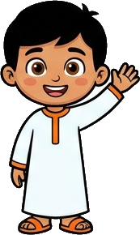
Lumio English
Homework & Goodbye
29 / 29
See you next time!
1. Play Lesson 10 on Lumio English
2. Say each word to your family
3. Earn your three stars!
Notes:
Assign homework. Warm goodbye.

